Slide 1


1.0
'Direct to Consumer Product'

Slide 2
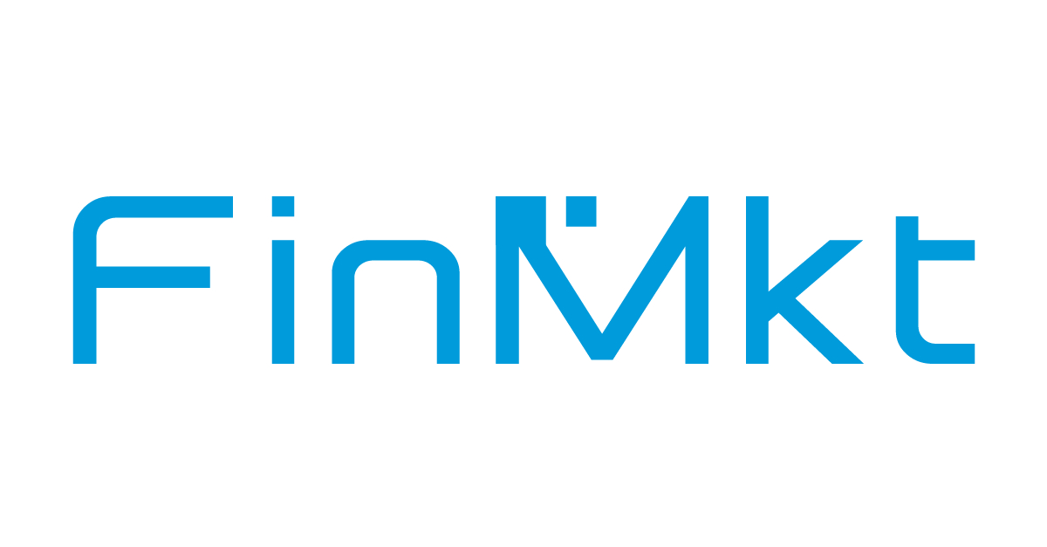
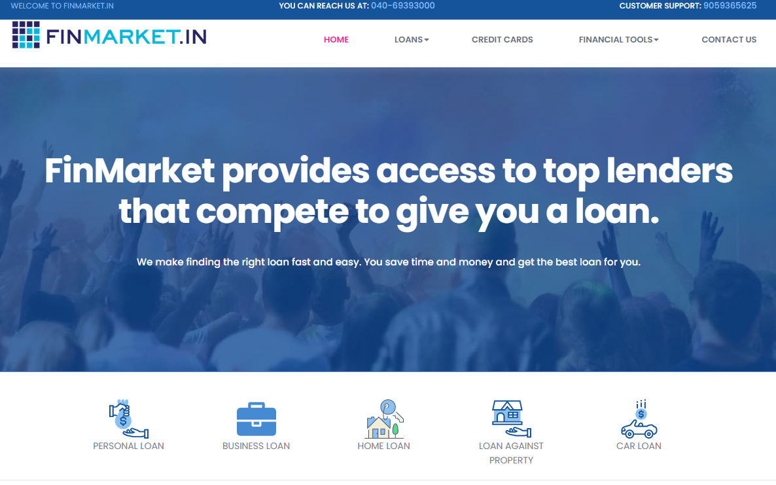
FinMarket.in
https://finmarket.in
Personal Loan- (Travel, Marriage, etc) - https://finmarket.in/personal-loan
Home Loan (Purchase, Construction)- https://finmarket.in/home-loan
Plot Loan - https://finmarket.in/plot-loan
Loan Against Property - https://finmarket.in/loan-against-property
Business Loan - https://finmarket.in/business-loan
Car Loan - https://finmarket.in/car-loan

Slide 3
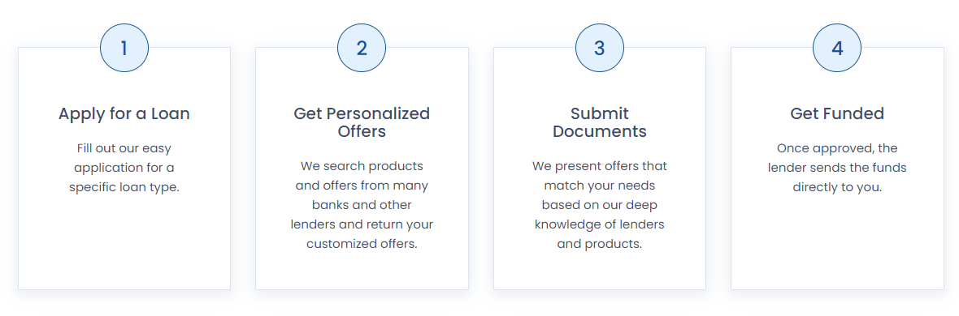
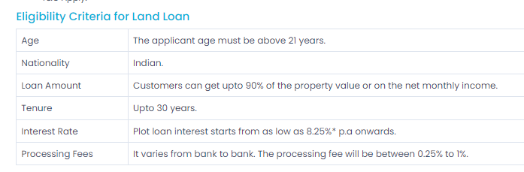
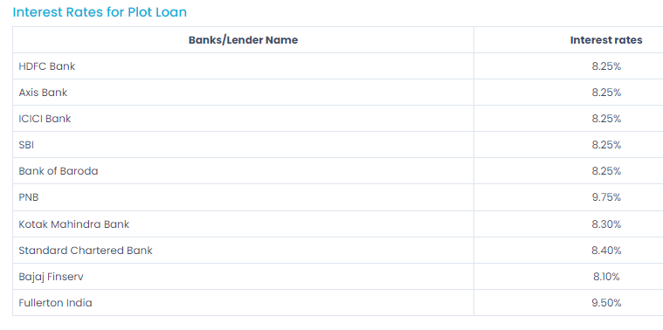
Loan Simplified in four steps
Eligibility for Land Loan (Each Loan has its own criteria)
How It Works
Different Banks/NBFCs have different interest rates

Slide 4
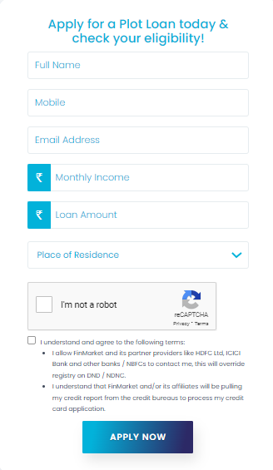
Loan Enquiry Form

Slide 5
What actually Happens during the process.
Once the customer fills the details in the Enquiry Form it gets captured in the Reporting Portal.
Loan application gets assigned to one of our sales rep.
From the Reporting Portal, one of our reps would pick the Loan application details and call the customer.
Rep would take all the required details from the customer(KYC).
Then the Rep would do the basic vetting for the eligibility of the customer.
Rep would reach out to the customer and explain the available offers.
Once the customer chooses the offer, then Rep would login the application in the loan offering bank website.
After log in the Bank will process the application and approve/decline it with in 3 to 4 days.
Then it the money gets disbursed in customer’s account.

Slide 6
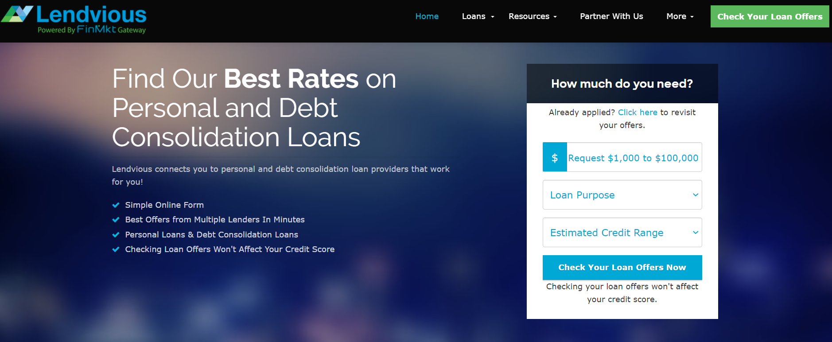
Lendvious – FinMkt’s own Partner
https://www.lendvious.com

Slide 7
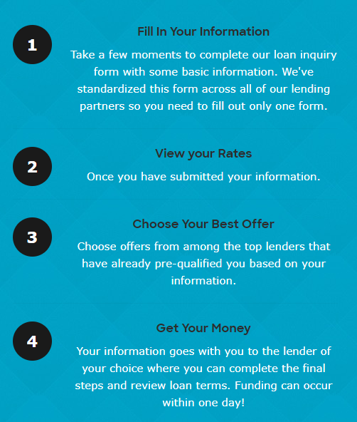
It’s Simplified in four steps

Slide 8
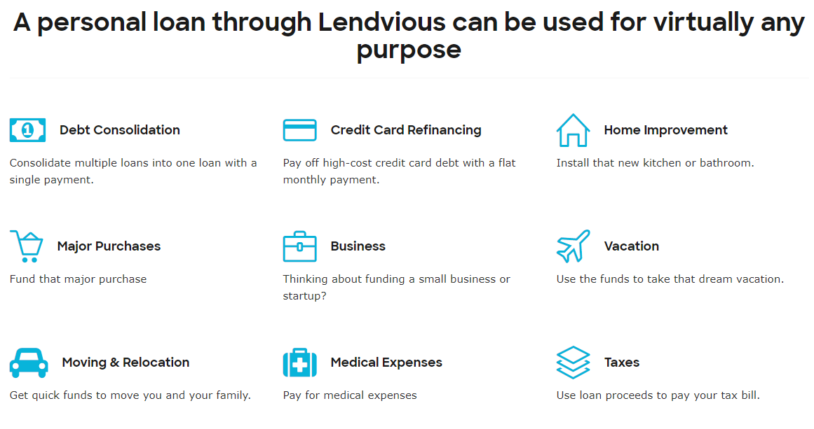
Use as you like

Slide 9
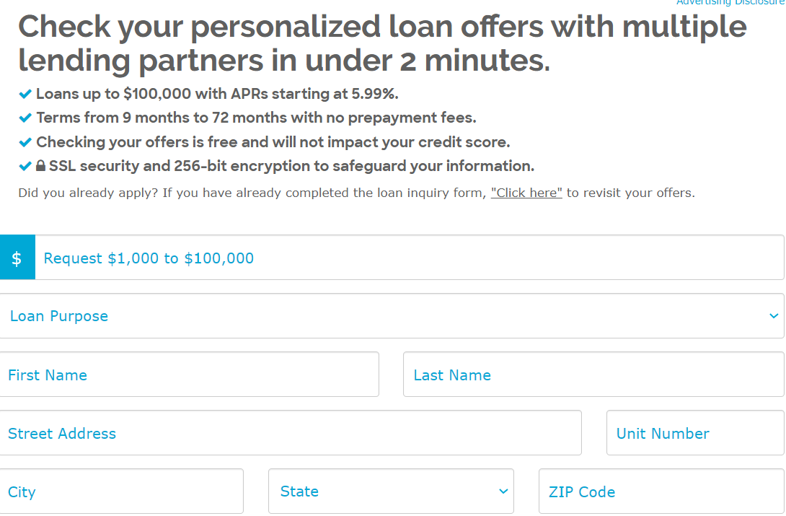
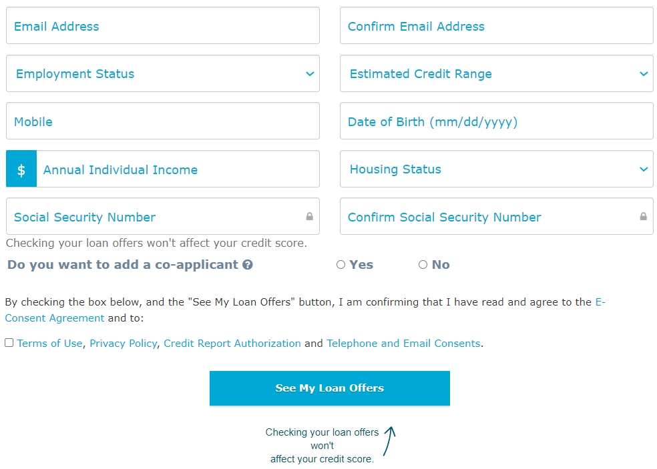
Get Loan Offers

Slide 10
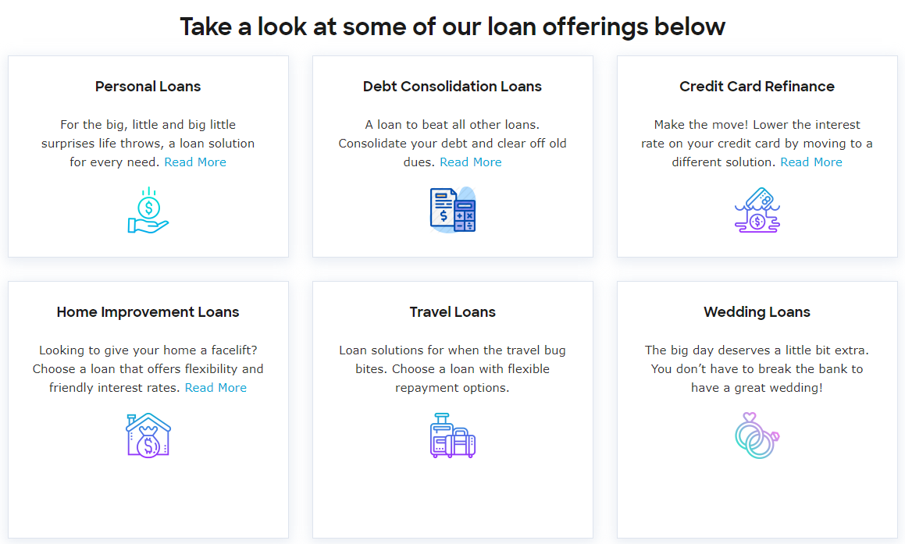
Types of Loans and Benefits
Benefits:
One Platform, Many Lending Partners
Real Time Pre-qualification
Quick Funding

Slide 11
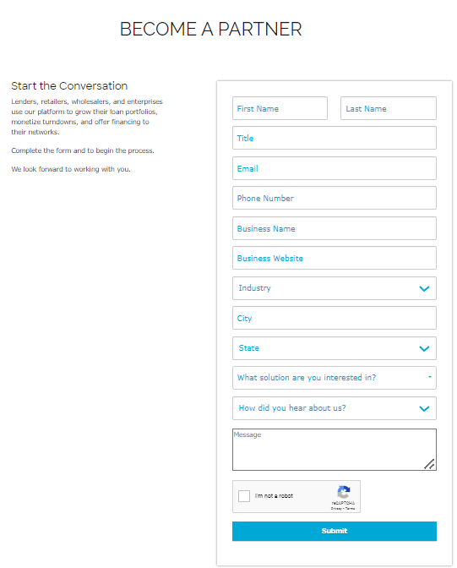
Become a Partner 2.1: Co- Brands- (Partners whose platform is very similar to FM) 2.2: White Label Partner (Partner who seeks their own style of design)

Slide 12
Thank You

